Slide 1


Introduction to Redis
Abel Vilalta Planas
abel.vilalta@codecrafters.com

Slide 2
What is Redis?
“Redis is an open source, BSD licensed, advanced key-value store. It is often referred to as a data structure server since keys can contain strings, hashes, lists, sets and sorted sets. ” - redis.io
“Redis has many different use cases. The simplest way to describe it is something between a traditional database and doing computations in memory. Redis exposes data structures that are accessed in memory via a set of commands. ” – Salvatore (Redis creator)

Slide 3
Redis Features
Extremely fast!
Atomic operations on common abstract data types:
Strings, hashes, lists, sets, sorted sets
In-memory but Persistence mechanisms
Publisher-Subscriber
LUA scripting
Transactions
Replication
Client libraries in multiple languages (.NET, Java, Ruby…)

Slide 4
NOSQL
Schema agnostic
Non-relational
Open-source
Scaling horizontally
Highly distributed
Types:
Document databases : MongoDB, RavenDB…
Graph stores : Neo4J…
Key-Value stores,: Riak, Redis…
Wide-Column stores: Cassandra..

Slide 5
Redis vs other NOSQL databases
Redis is a key-value store.
Redis uses keys to query.
Redis does not use indexes.
Redis is mainly used in-memory.

Slide 6









Who uses Redis?
http://redis.io/topics/whos-using-redis

Slide 7
Redis data structures
Redis is not a plain key-value store, actually it is a data structures server, supporting different kind of values.
5 different main types:
Strings
Lists
Sets
Sorted sets
Hashes

Slide 8
Redis Keys
Redis keys are used as simple strings.
Must be unique.
Can be expired.
Recommended to not be large (performance) neither short (easy to understand what they identify).
Recommended to stick to a schema like:
object-type:id => user:100
Common Key commands:
DEL key
EXISTS key
DUMP key
EXPIRE key

Slide 9
Strings
Most basic Redis type.
Redis Strings are binary safe, they can contain any kind of data, like a JPEG image.
Common use to store objects in a serialized format.
Up to 512Mb.
Most common string commands:
SET
GET
APPEND
INCR and DECR
MGET
MSET
GETRANGE
STRLEN

Slide 10

Strings Use Cases
Counters (via INCRBY or DECRBY).
Store images.
Store JSON documents (which fields must not to be manipulated by Redis).

Slide 11

Strings Demo

Slide 12
Lists
Lists of strings, sorted by insertion order.
New list items can be added to the beginning or end of the list.
Trimming operations.
Can be used to implement queues or stacks.
Most common list commands:
LPUSH and RPUSH
LREM
LSET
LINDEX
LRANGE
LLEN
LPOP and RPOP
LTRIM

Slide 13

List Use Cases
Great for queues and stacks.
Show latest items listings in your home page (LPUSH / LTRIM / LRANGE).

Slide 14
Lists Demo

Slide 15
Sets
Unordered collection of strings.
Not allowed repeated items.
Unions, intersections, differences.
Most common set commands:
SADD
SCARD
SDIFF, SINTER, SUNION
SISMEMEBER
SMEMBERS
SREM

Slide 16
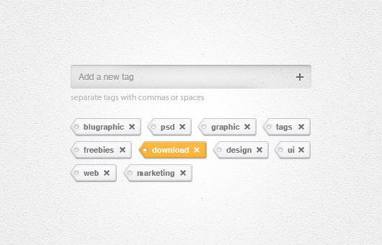
Sets Use Cases
Tagging systems
Tracking unique visitors
Who is online?
Online users
My friends
Online friends

Slide 17
Sets Demo

Slide 18
Sorted Sets
Similar to sets.
Each item associated with a score.
Score used to order the set.
Most common sorted set commands:
ZADD
ZCARD
ZCOUNT
ZINCRBY
ZRANGE
ZRANK
ZREM
ZSCORE

Slide 19
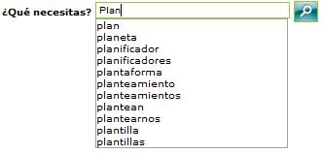

Sorted Sets Use Cases
Leaderboards and related problems
Autocomplete searches
Order by user votes and time
ZADD “P” 0
ZADD “PL” 0
ZADD “PLA” 0
ZADD “PLAN” 0
ZADD “PLAN*” 0
ZADD “PLANE” 0
ZADD “PLANET” 0
ZADD “PLANETA*” 0
ZADD “PLANI” 0
ZADD “PLANIF” 0
ZADD “PLANIFI” 0
ZADD “PLANIFIC” 0
ZADD “PLANIFICA” 0
ZADD “PLANIFICAD” 0
ZADD “PLANIFICADO” 0
ZADD “PLANIFICADOR*” 0

Slide 20
Sorted Sets Demo

Slide 21
Hashes
Maps between string fields and string values.
Most common sorted set commands:
HSET
HMSET
HGET
HMGET
HGETALL
HDEL
HEXISTS
HINCRBY
HKEYS
HVALS

Slide 22

Hashes Use Cases
Good for representing objects and storing data types other than strings and integers.
Player profiles
Session management
HSET users:1 name “Lu Meng” intelligence 41
HSET users:1 intelligence
41

Slide 23
Hashes Demo

Slide 24
Naming conventions
Best practice to use namespaces when using Redis.
Namespaces avoids name collisions and help organize your keys based on your application.
Redis natively does not support namespaces. Key name conventions are used to mimic it. Colon is the default accepted naming convention for separators, and namespaces are lowercased.
Namespace:key_name => online_store:music:1
ServiceStack.Redis uses the follow convention:
urn:type:id => urn:videos:1
Hash also can be used to identify part id keys and colons for namespaces:
hotel_store:spain#25
Nothing stops to make your own naming conventions. Just be consistent and clear!

Slide 25
Publish / Subscribe
Redis implements a publisher / subscriber pattern.
“publish–subscribe is a messaging pattern where senders of messages, called publishers, do not program the messages to be sent directly to specific receivers, called subscribers, but instead characterize published messages into channels without knowledge of which subscribers, if any, there may be. Similarly, subscribers express interest in one or more channels and only receive messages that are of interest, without knowledge of which publishers, if any, there are.” – Wikipedia

Slide 26
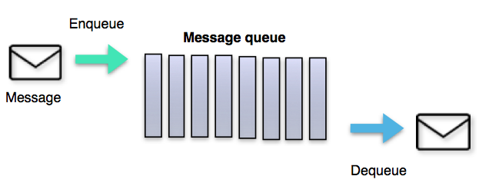
Message Queues
Message queuing allow applications to communicate by sending messages to each other.
Communication is established asynchronously.
A lot of implementations: JMQ, RabbitMQ, Azure Queues, SQS…

Slide 27
Message Queue Features
Durability
Security policies
Message purging policies
Message filtering
Delivery policies
Routing policies
Batching policies
Queuing criteria
Receipt notification

Slide 28
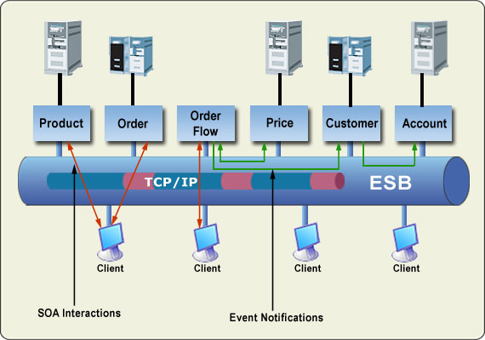
Enterprise Service Bus
An enterprise service bus (ESB) is implementing a communication system between mutually interacting software applications in a service-oriented architecture (SOA). - Wikipedia
Buzz word and so used very lightly: Azure Service Bus vs Biztalk (EAI).

Slide 29
ESB Features
Orchestration
Transformation
Transportation
Mediation
Messaging
Adapters
Security
Validation
Routing and transformation

Slide 30
ESB Products
A lot of products on the market: IBM WebSphere ESB, Biztalk ESB, Oracle ESB, MuleSoft ESB, Azure ESB…
Every one implements different features and capabilities. There is not a standard.

Slide 31
Comparison Redis PubSub, ESB, Message Queues
It’s not an easy comparison (between ESB and Message Queues) due to the overlap of features on every product.
Most (not all) Message Queues and ESB implement all the features from Redis Pub/Sub.
Redis is a key-value database whereas ESB/Message Queues are not.
Redis can act as unreliable queue.

Slide 32
Pros of Redis PubSub
Already implemented mechanism on Redis. No need to introduce new systems.
High speed vs other systems if used in-memory.
Non over architectected / over bloated and easy to use.
Is the perfect solution if not needed all the features from message queues or ESB.

Slide 33
Cons of Redis PubSub
No reliable (depending on the scenario…)
Messages can be lost on a network failure / server down.
No acknowledgment of arrival.
No Delivery guarantee: at least once / at most once.
No retries of failed messages.
No dead lettering.
No duplicate detection.
No ordered messages delivery (clustered systems).
No unicast support.
No security on messages (who can access / receive).
No scheduled delivery.
Almost all of the benefits of ESB / Queues are lost…

Slide 34
Redis PubSub
Commands used on Redis PubSub:
PSUBSCRIBE
PUBLISH
PUNSUBSCRIBE
SUBSCRIBE
UNSUBSCRIBE

Slide 35
PubSub Demo

Slide 36
Persistence Options
Redis supports 2 types of Persistence:
RDB (Redis Database Snapshots) : Performs point-in-time snapshots of your dataset at specified intervals.
AOF (Append Only Mode) : Creates a log of every write operation received by the server, that will be played again at server startup, reconstructing the original dataset.

Slide 37
RDB advantages and disadvantages
Advantages:
Small file of that single-point-in-time.
Best performance cost since is scheduled at certain times and run on another thread.
Good for backups of databases.
Disadvantages:
Bad for minimizing the loss of data. It does not track all the data at every time. The amount data lost can depend of how scheduled is the RDB process.

Slide 38
AOF advantages and disadvantages
Advantages:
Best for disaster recovery, since creates a log and appends every command issued.
At most you can lose one command.
Disadvantages:
More big files than RDB ones.
Performance penalty due to be writing constantly to disk.

Slide 39
Replication
Redis can use replication through a master-slave scenario.
Slaves should be read-only.
Multiple clients can read from slaves and master. Writes only should happen on the master.
Enhances scalability, redundancy and fail-over.
Slaves can accept connection from other slaves (graph-like).
Are used in Redis Cluster for Sharding data.
At least 2 slaves is recommended for a proper architecture.
Sentinel Redis servers guards for fail-overs an elects a new master via a quorum algorithm.
Replication is totally asynchronous, and can only done from master to slave, and slave to slave.

Slide 40
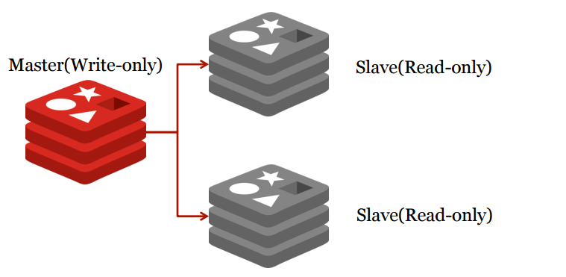
Replication

Slide 41
Transactions
Support for transactions: all elements will be executed non interrupted or not executed at all.
Uses MULTI command to start the transaction, queues up all commands and finally applies the EXEC command to execute them all or DISCARD command to discard those.
WATCH command observe changes to the queued commands after executed the MULTI command to avoid race conditions.

Slide 42
Transactions Demo

Slide 43
Redis and C#
Different implementations of client libraries for C#. Most famous are:
ServiceStack.Redis
StackExchange.Redis
Easy way to interact programmatically through Redis.

Slide 44
Redis and C# Demo

Slide 45
References
https://redis.io
https://www.tutorialspoint.com/redis/redis_keys.htm
http://www.slideshare.net/DanielMazzini/pon-tus-aplicaciones-a-100-con-redis
https://en.wikipedia.org/wiki/Enterprise_service_bus
https://en.wikipedia.org/wiki/Message_queue
http://highscalability.com/blog/2011/7/6/11-common-web-use-cases-solved-in-redis.html
Course materials:
https://github.com/zodraz/RedisIntroduction

Slide 46

Questions and Answers

Slide 47
Thank you

